Slide 1
Building Decision Trees and Random Forests
Build Decision Tree Models
Build Random Forest Models

Slide 2

Build Decision Tree Models

Slide 3
Decision Tree
Violations > 0
Yes
No
Not preferred
Account age > 1 yr.
Yes
No
Balance > $50k
Not preferred
Yes
No
Preferred
Not preferred

Slide 4
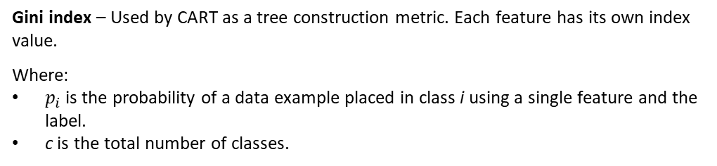

Classification and Regression Tree (CART)
$$G=1−\sum_{i=1}^{c}{{\left(p_{i}\right)}^{2}}$$
Gini index – Used by CART as a tree construction metric. Each feature has its own index value.
Where:
$p_{i}$ is the probability of a data example placed in class i using a single feature and the label.
c is the total number of classes.
Gini index splits training set into two based on a feature with a threshold.
Example: Split "Violations" based on greater than 0.
Gini index determines purity of decision node.
Purest node is one in which all examples at decision node belong to either class.
Most impure node is when there is a 50–50 split.
Feature with highest purity (G = 0) is root node.

Slide 5
Gini Index Example (Slide 1 of 3)
Account age > 1 | Violations > 0 | Balance > $50,000 | Preferred
Yes | No | Yes | No
Yes | Yes | Yes | No
No | No | Yes | No
Yes | No | Yes | Yes
Yes | No | No | No
Yes | No | Yes | Yes
No | No | Yes | Yes
No | Yes | Yes | No

Slide 6
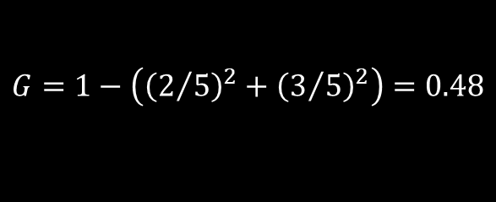
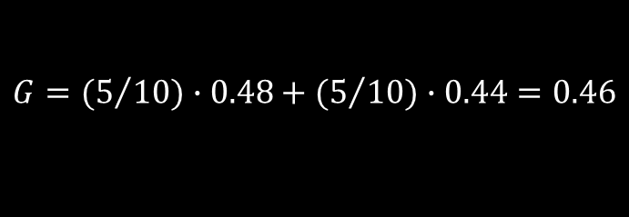
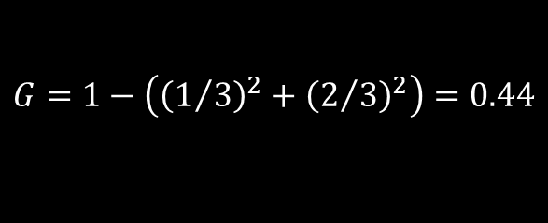
Gini Index Example (Slide 2 of 3)
Calculate Gini index for "Account age" = "Yes".
Calculate Gini index for "Account age" = "No".
Weighted sum of both:
$$G=1−\left({\left(2/5\right)}^{2}+{\left(3/5\right)}^{2}\right)=0.48$$
$$G=1−\left({\left(1/3\right)}^{2}+{\left(2/3\right)}^{2}\right)=0.44$$
$$G={(5}/{10)∙0.48+{(5}/{10)∙0.44=0.46}}$$

Slide 7
Gini Index Example (Slide 3 of 3)
Process is repeated for other two features.
When calculated, the resulted indices are:
Account age = 0.46
Violations = 0.38
Balance = 0.43
"Violations" has lowest index, so it will be root decision node.
CART splits dataset into another subset, evaluating purity again.
Repeats process for sub-subsets, etc.
Splitting stops when:
There's no more impurity to reduce.
Tree reaches maximum depth specified in hyperparameter.

Slide 8
CART Hyperparameters
Hyperparameter | Description
max_depth | Number of decision nodes from root to farthest leaf. If not specified, CART will keep splitting until: G for all leaves is 0. All leaves are less than min_samples_split. Regularizes training to avoid overfitting.
min_samples_split | Number of data examples required to split a decision node. Increase to constrain model, reduce overfitting. Beware of constraining model too much, underfitting it.
min_samples_leaf | Number of data examples required to be at a leaf node. Increase to reduce overfitting. Beware of underfitting.
splitter | "best" (default) calculates Gini index. "random" splits feature at random and then calculates Gini index. Repeats process and finds split with best Gini index. Random requires less overhead. Random may be better at avoiding overhead in certain cases. Random does not always make optimal splitting decisions.

Slide 9
Pruning
Pruning: The process of reducing the overall size of a decision tree.
Eliminates nodes, branches, and leaves that provide little value to the task at hand.
Helps minimize overfitting.
Specifying hyperparameters like max depth is "pre-pruning."
Three major pruning methods:
Pruning Method | Description
Reduced-error | Converts subtree into single leaf (most common classification). Subtree with highest reduction in error is pruned. Simple and quick—a good first option.
Minimum error | Error rate is weighted according to examples at branch. If error of pruning subtree is smaller than not pruning it, it is pruned. Doesn't do well with class imbalance or with many classes.
Cost complexity | "Worth" of subtree is increase in error cost of pruning, divided by number of leaves. Subtrees with lowest "worth" are pruned. Slower than other methods.

Slide 10
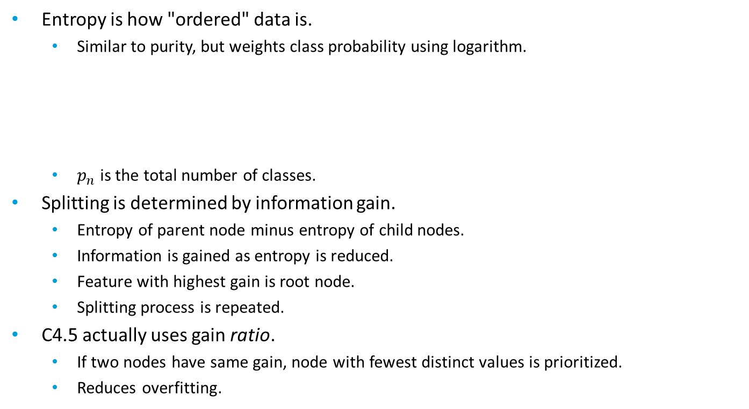
C4.5
C4.5: A decision tree algorithm that constructs trees with regard to entropy and information gain.
Entropy is how "ordered" data is.
Similar to purity, but weights class probability using logarithm.
$p_{n}$ is the total number of classes.
Splitting is determined by information gain.
Entropy of parent node minus entropy of child nodes.
Information is gained as entropy is reduced.
Feature with highest gain is root node.
Splitting process is repeated.
C4.5 actually uses gain ratio.
If two nodes have same gain, node with fewest distinct values is prioritized.
Reduces overfitting.
$E=−{(p}_{1}∙\log_{2}{p_{1}}+p_{2}∙\log_{2}{p_{2}+⋯+p_{n}∙\log_{2}{p_{n}}}$)

Slide 11
Continuous Variable Discretization
Continuous Variable Discretization: The process of converting a continuous variable into a discrete one.
Prevents continuous variable from splitting off into many decision nodes.
Would otherwise create very large, inefficient trees.
Simplifies performance of model.
Continuous variable values are placed into bins.
Example: "Age in years" might have around 130 bins.
Typically done during data engineering.

Slide 12
Bin Determination
Must select number of bins and the range of values in the bins ("width").
Configure both to minimize entropy.
Number of bins is dependent on dataset.
Five or more bins for thousands of data examples.
Example: "Age in decades" will have 13 bins.
Increasing number of bins increases complexity of model.
Approaches to determining width: equal-width and equal-frequency.
Equal-width:
Each bin spans same range of values.
Sensitive to outliers, but leads to higher information loss.
Equal-frequency:
Each bin contains same number of values.
Minimizes information loss, but less sensitive to outliers.
Correlation of feature to label can help determine bin number/width.
Complex binning is more justified when there is a correlation.

Slide 13
One-Hot Encoding
One-Hot Encoding: The process of converting a non-ordinal categorical variable into two or more constituent variables.
For each example, all variables are 0 except for one.
"Color" variable normally is 0 for red, 1 for blue.
Implies a natural order, even though there is none.
When one-hot encoded:
Makes it easier for decision trees to work with data.
Also works for multi-class labels.
May slow down training process.
Data Example | Red? | Blue?
Vehicle 1 | 1 | 0
Vehicle 2 | 0 | 1
Vehicle 3 | 1 | 0

Slide 14
Decision Tree Algorithm Comparison
Algorithm | Splitting Metric | Pruning Method | Supports Classification and Regression? | Supports Multi-Class Splitting? | Supports Missing Values?
CART | Gini index | Cost complexity pruning | Both | No | Yes
C4.5 | Information gain ratio | Error-based pruning | Both | Yes | Yes

Slide 15
Decision Trees Compared to Other Algorithms
Decision tree advantages:
Don't require as much data preparation.
Tend to be simple and easy to interpret.
Typically fast.
Applicable to many different types of tasks.
Decision tree disadvantages:
Prone to overfitting.
Can become complex if you're not careful.
Cannot derive significance of features.
May perform worse on dataset with many features.
Not always a "best" use case for decision trees.
Experiment with multiple algorithms and compare performance.

Slide 16

Build a Decision Tree Model
Consider decision trees for classification or regression.
Consider decision trees if you want the model to be easy to interpret/demonstrate.
Consider that less data preparation may be necessary than with other algorithms.
Consider that you may need to discretize continuous variables.
Consider that you may need to one-hot encode variables.
Be aware that decision trees are prone to overfitting.
Perform pre-pruning by tuning hyperparameters.
Consider pruning methods like reduced error pruning to further minimize overfitting.
Use C4.5 over CART when multi-class splitting is required.
Evaluate decision trees using the same metrics introduced earlier.

Slide 17
Use Python for Decision Trees
Use scikit-learn's DecisionTreeClassifier() and DecisionTreeRegressor() classes to build decision tree models:
model = sklearn.tree.DecisionTreeClassifier(criterion = 'gini', max_depth = 5)
model = sklearn.tree.DecisionTreeRegressor(max_depth = 5)
Use class objects to call much of the same methods as in other algorithms.
sklearn.tree.export_graphviz(model, out_file = dot_data, feature_names = X_train.columns.values.tolist(), class_names = ['0', '1'])

Slide 18
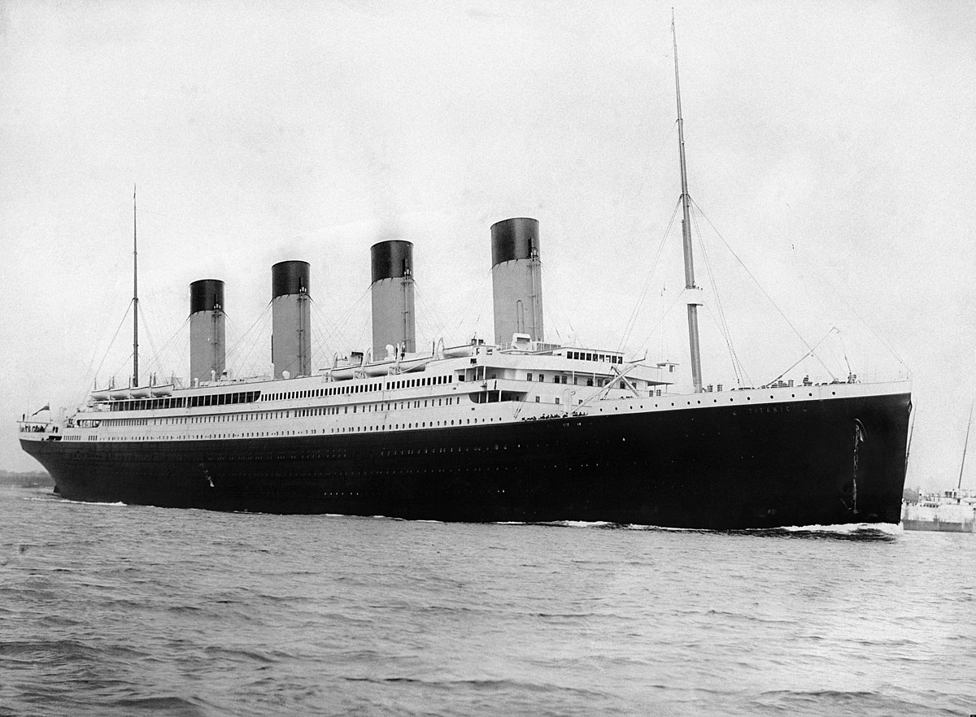
Activity: Building a Decision Tree Model
Your Titanic logistic regression model has done well.
It mat not be the best algorithm for the job, though.
You'll build a competing model using decision trees, then compare the results.
Experimenting with different algorithms is important.

Slide 19
Build Random Forest Models

Slide 20
Ensemble Learning
Ensemble Learning: A type of machine learning in which predictions from multiple models are considered in combination.
Intended to obtain a more skillful prediction than one model in isolation.
Aggregating multiple models usually leads to better predictions.
Example: Train several models for classifying heart disease in patients.
Choosing the one with the best score isn't always the best approach.
In ensemble learning, the classification that gets the most votes wins out.
Example training results:
Logistic regression
SVMs
CART
Ensemble would choose class 1, even though SVMs had highest accuracy.
Consider how rolling a die 100,000 times will likely give you a more even probability distribution than rolling it 100 times.

Slide 21
Random Forest
Data Example
Class 1
Class 0
Class 0
Mode = Class 0

Slide 22
Out-of-Bag Error
Cross-validation isn't necessary with random forests.
Bagging process relies on representative sampling.
Samples about 2/3 of data for a given tree.
Remaining 1/3 is left out of that tree (called out-of-bag).
No one tree sees all data, but entire forest does.
You can evaluate performance of each tree based on data it hasn't seen.
Returns an error.
Average each error to get out-of-bag error for forest.
Process:
Each example left out of tree is used to validate training on that tree.
Each tree predicts a class for example, then majority vote is taken.
Majority vote compared to actual label.
Out-of-bag error indicates ratio of incorrect majority predictions to correct predictions.
Considers all out-of-bag examples.
Error of 0.19 means 19% of predictions were incorrect.

Slide 23
Random Forest Hyperparameters
Most individual decision tree hyperparameters apply to forests as well.
Max depth, minimum samples for a split, etc.
Can't change splitter—forced to "random".
Unique hyperparameter: number of trees in forest (n_estimators).
The more trees you add, the more skillful the prediction will be.
More trees leads to more computational cost.
Usually diminishing returns after a few hundred trees.

Slide 24
Feature Selection Benefits
Random forests can also reveal the importance of features.
For diabetes risk, age may be more important in making predictions than height.
Random forests consider how well decision nodes for features reduce impurity.
Takes weighted average of impurity across all trees.
Amount of data examples at node influences weight.
Output for each feature is a value between 0 and 1.
All features together add up to 1.
Example feature importance values:
Body weight: 35%
Age: 21%
Blood pressure: 14%
Weekly exercise: 13%
Family history: 10%
Race: 6%
Others: 1%
Because "Others" is so low in importance, you may want to remove it from training.

Slide 25
Build a Random Forest Model
Consider random forests to improve model skill and reduce overfitting.
Use bagging with random forests.
Consider that bagging can make cross-validation unnecessary.
Use out-of-bag error to evaluate performance of trees in forest.
Use most of the same hyperparameters as with individual trees.
Consider limiting the number of trees to around a few hundred.
Use random forests for feature selection.
Evaluate random forests using the same metrics introduced earlier.

Slide 26
Use Python for Random Forests
Use scikit-learn's RandomForestClassifier() and RandomForestRegressor() classes to build decision tree models:
model = sklearn.tree.RandomForestClassifier(n_estimators = 100, criterion = 'gini', max_depth = 5)
model = sklearn.tree.RandomForestRegressor(n_estimators = 100, max_depth = 5)
Use class objects to call much of the same methods as in other algorithms.
model.oob_score_
model.oob_decision_function_
model.feature_importances_

Slide 27
Activity: Building a Random Forest Model
You want to try the Titanic model on more algorithms.
You built a decision tree, but multiple trees in an ensemble may perform better.
You'll build a random forest classifier and see how it does.

Slide 28
In your own environment, how might you use decision trees to solve business problems?
In your own environment, how might you use random forests to solve business problems?

